Slide 1
New York Property
Fraud Analytics
Team 5
Yao Lu
Bei Zhang
Roger Geng

Slide 2

Overview
Data Preprocessing
Feature Engineering
Algorithms
Results
Contents

Slide 3
Overview
- 1 Million Records x 30 Fields
- 30 Fields include:
Property Location
Property Size
Property Value
Regulatory Information
- Does this property assessment look abnormal?
Full market value (FULLVAL)
Assessed value (AVLAND & AVTOT)
- Create two different fraud scores

Slide 4
Overview
Data Preprocessing
Feature Engineering
Algorithms
Results
Contents

Slide 5
Data Preprocessing
2.5% of ZIP
unpopulated
1. Sort by BBLE
2. Forward Fill ZIP
BBLE ZIP
2021370005
10027
2018120082
2021370002 10031
10031
2018120076 10027
2038510006 10142

Slide 6
Data Preprocessing
LTFRONT LTDEPTH
LTFRONT/LTDEPTH
Pearson Correlation
0.49
BLDFRONT/BLDDEPTH
Pearson Correlation
0.60
Group by BORO, TAXCLASS
Take the mean
132
100
0 130
200
380
0 0
0 0

Slide 7
Data Preprocessing
STORIES:
Group by ZIP and TAXCLASS
Then take the mean
FULLVAL:
Average price per square foot,
Grouped by ZIP
Multiply it back

Slide 8
Overview
Data Preprocessing
Feature Engineering
Algorithms
Results
Contents

Slide 9
Feature Engineering

Slide 10
Variables Transformation
Create 3 sizes
· Lot area: LOTAREA = LTFRONT * LTDEPTH
· Building area: BLDAREA = BLDFRONT * BLDDEPTH
· Building volume: BLDVOL = BLDAREA * STORIES

Slide 11
Variables Transformation
FULLVAL
AVLAND AVTOT
LandArea
BuildArea
BuildVol
ALL
ZIP
ZIP3
TAXCLASS
BORO
STORIES
BORO + TAXCLASS
Divided by
Group by
3 x 3 x 7 = 63

Slide 12
Variable
Standardization
Scale to be Comparable

Slide 13
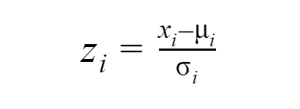
Variable
Standardization
z-scores have a distribution with a mean of 0 and a standard deviation of 1.

Slide 14
Principal Component Analysis
Variable
Standardization
Reduce dimension
Scale to be Comparable

Slide 15
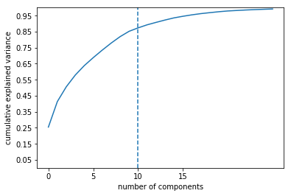
 | Percentage of explained variance
PC1 | 25.44%
PC2 | 15.94%
PC3 | 9.26%
PC4 | 7.29%
PC5 | 5.87%
PC6 | 4.99%
PC7 | 4.67%
PC8 | 4.42%
PC9 | 4.03%
PC10 | 3.32%
Principal Component Analysis
(PCA)
To remove these correlations and achieve a reduction in dimensions

Slide 16
PC Standardization
Principal Component Analysis
Scale to be Comparable
Variable
Standardization
Reduce dimension
Scale to be Comparable

Slide 17
Overview
Data Preprocessing
Feature Engineering
Algorithms
Results
Contents

Slide 18
Autoencoder

Slide 19

Algorithms
Input Layer
Encoder Layer
Decoder Layer
Loss function: MSE
Optimizer: Adadelta
Input layer
Nodes: 10
Encoder layer
Compression factor: 1.1
Nodes: 10/1.1=9
Activation function: tanh
Output value range: (-1, 1)
Decoder layer
Nodes: 10
Activation function: linear
Output value range: ($−∞,∞$)
Tanh
Linear

Slide 20
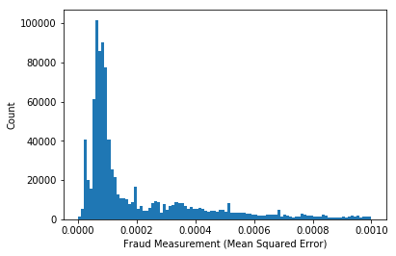
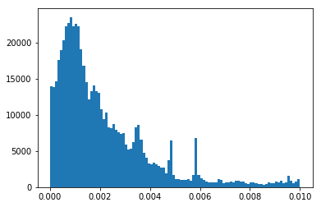
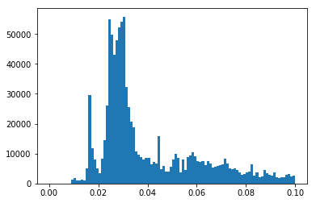
Algorithms
MSE
MAE
Root Sum Squared

Slide 21
Mahalanobis Distance

Slide 22
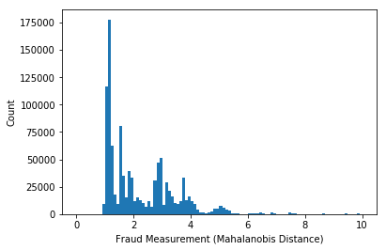

Algorithms
Mahalanobis Distance
$$D\left(p\right)= \sqrt{\sum_{i}^{n}{{(\frac{F_{i}−μ_{i}}{σ_{i}})}^{2}}}$$

Slide 23
Overview
Data Preprocessing
Feature Engineering
Algorithms
Results
Contents

Slide 24
Results
Top 10
Top 1%
Bottom 1%
90%
49%
9%
Percentage of overlapping entries
for the two ranking systems

Slide 25
Results
Rank | RECORD | LT FRONT | LT DEPTH | STORIES | FULL VAL | Mahal Rank | Auto Encoder Rank | Combined Rank
1 | 632817 | 100 | 100 | 2.5 | 330000 | 1 | 1 | 1
2 | 126405 | 159 | 159 | 2 | 817000 | 2 | 2 | 2
3 | 126400 | 131.2 | 131.2 | 6 | 175778 | 3 | 3 | 3
4 | 138830 | 100 | 100 | 3 | 800000 | 4 | 4 | 4
5 | 585119 | 100 | 100 | 2 | 340000 | 5 | 5 | 5
6 | 108897 | 100 | 100 | 2 | 700000 | 6 | 6 | 6
7 | 85887 | 101 | 101 | 31 | 281677 | 7 | 7 | 7
8 | 918306 | 100 | 100 | 2 | 370000 | 8 | 8 | 8
9 | 934794 | 100 | 100 | 2.7 | 419000 | 9 | 10 | 9.5
10 | 934781 | 131.2 | 131.2 | 16 | 158864 | 10 | 11 | 10.5

